Slide 1
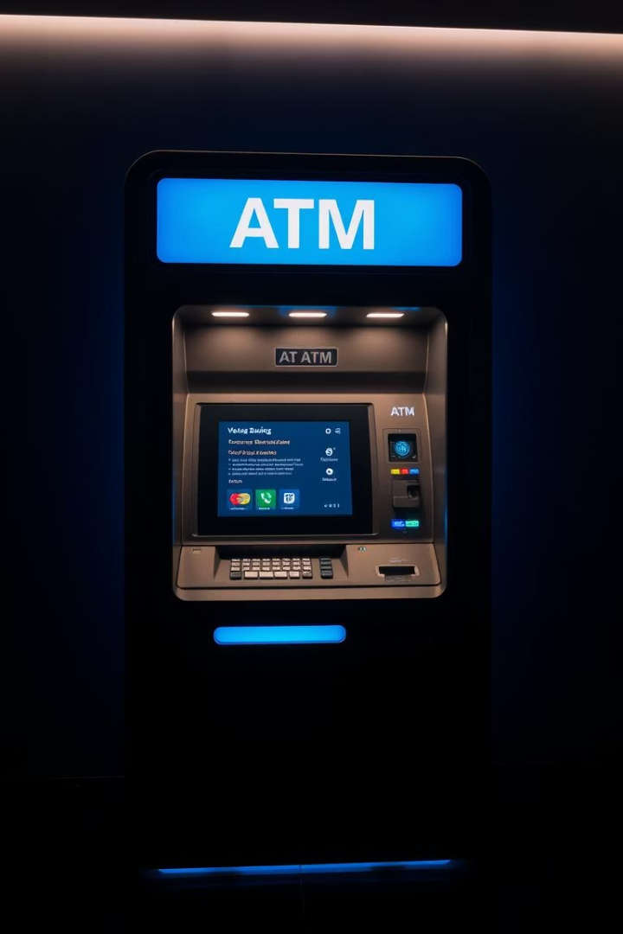
Revolutionizing Banking: Your ATM System Online
The future of banking is digital and accessible. Our web-based ATM system enhances convenience and user experience for seamless online transactions.

Slide 2
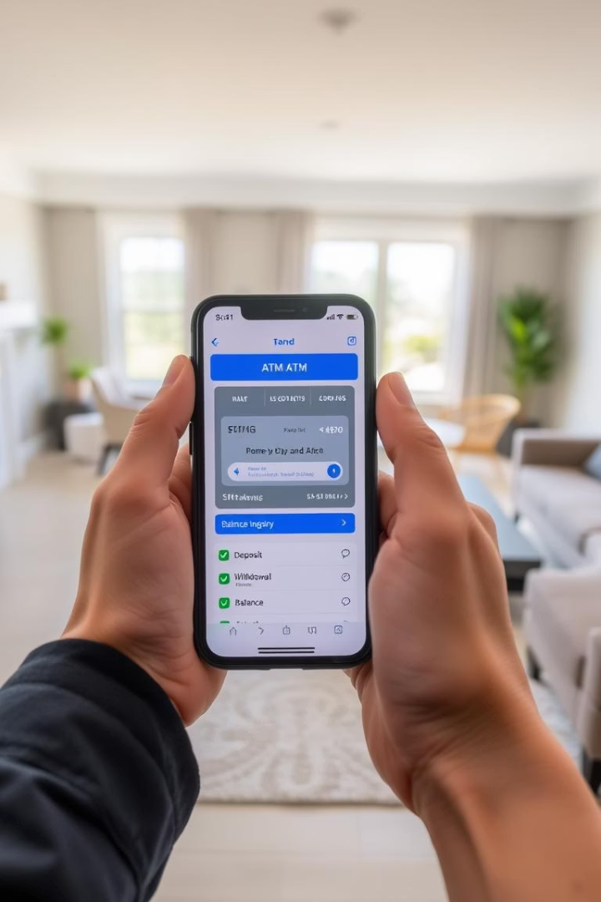
Why a Web-Based ATM?
24/7 Accessibility
Access accounts anytime, anywhere without physical ATM limits.
Reduced Infrastructure Costs
Eliminate the need for physical ATM maintenance and expenses.
Expanded Service Offerings
Provide a wider range of banking services online.
Data Analytics
Gather user data to personalize banking experiences effectively.

Slide 3
Key Features and Functionalities
Secure Login
Balance Inquiry
Multi-factor authentication ensures account safety.
Real-time display of account balances for quick checks.
Fund Transfers
Transaction History
Seamless transfer between accounts within the platform.
Comprehensive records give transparency to past transactions.
Bill Payments
Customer Support
Integrated bill pay services streamline user workflows.
24/7 chatbot assistance enhances user engagement.

Slide 4
Security Measures
Encryption
Two-Factor Authentication
Fraud Detection
Regular Security Audits
End-to-end data encryption secures all communications.
Real-time monitoring identifies suspicious account activities.
Verifies identities to prevent unauthorized access.
Frequent assessments ensure up-to-date protection measures.
Compliance
Meets PCI DSS and relevant standards for secure handling.

Slide 5





User Interface (UI) and User Experience (UX)
Responsive Layout
Intuitive Design
Optimized for desktop, tablet, and mobile devices.
2
Easy interface for users of all skill levels.
1
Accessibility
WCAG compliant for users with disabilities.
3
Multi-Language Support
5
Accessible to diverse global user base through language options.
Personalization
4
Custom user profiles with adaptable preferences.

Slide 6





Technical Architecture
Cloud-Based Infrastructure
Scalable, reliable hosting through AWS or Azure platforms.
API Integration
Connects seamlessly with existing bank systems and services.
Database Management
Secure, efficient data storage using modern database technologies.
Programming Languages
Built with React and Node.js for robust performance.
Scalability
Designed to support an expanding user base effortlessly.

Slide 7
Implementation and Deployment
1
Phased Rollout
Gradual launch reduces disruptions and bugs.
2
User Training
Comprehensive guidance materials ensure adoption success.
3
Marketing and Promotion
Awareness campaigns drive usage and trust.
4
Monitoring and Maintenance
Continuous updates guarantee system reliability.
5
Feedback Collection
Iterative improvements based on user input.

Slide 8
The Future of ATMs: Innovation and Beyond
Contactless Transactions
AI-Powered Personalization
Enhanced Security Features
Supports Apple Pay, Google Pay for enhanced convenience.
Offers tailored financial advice and recommendations.
Biometrics like fingerprint and facial recognition ensure safety.
Blockchain Integration
Data Analytics
Secures transparent and tamper-proof transactions.
Real-time insights enable proactive system issue resolution.

